Slide 1
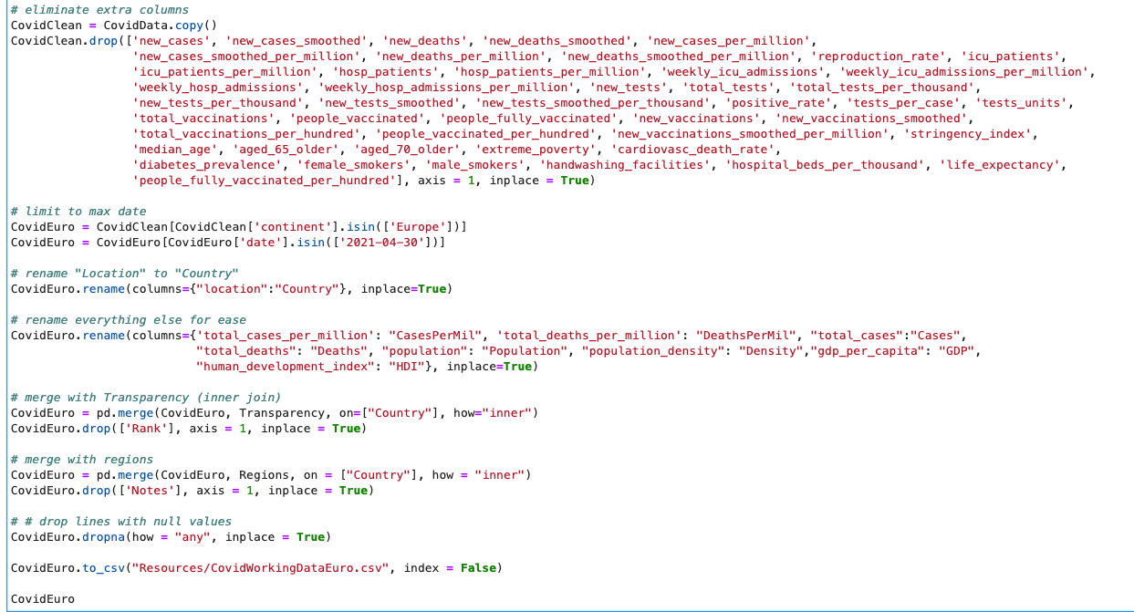
Data clean up
1) Pull in the csv file with 85580 records across 60 columns. Everything we tried to look at was general and murky.
2) Cut the down the data. We limited to the continent of Europe as of 4/30/2021 and were left with 48 records with 12 columns.
3) Renamed lots of fields because things like “total_deaths_per_million” were going to be horrible to query.
4) Merged via inner joins to add in corruption perception index and separate Europe into four regions.
6) Charts were throwing out errors, so we removed records with N/A values and were left with 40 records and 14 columns to work with.

Slide 2
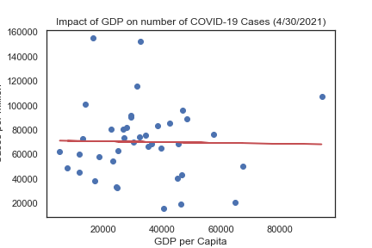
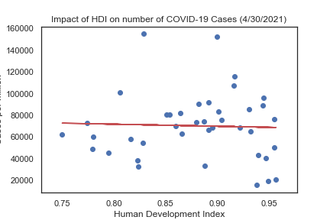
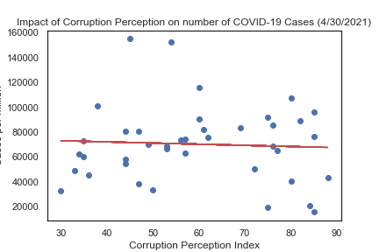
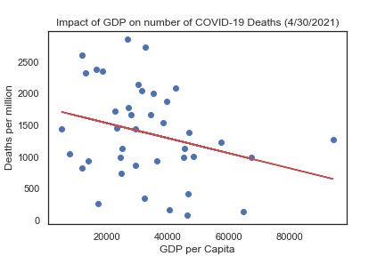
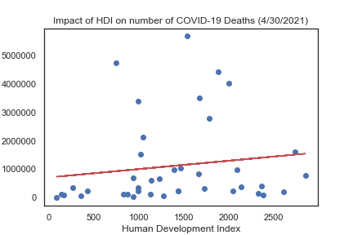
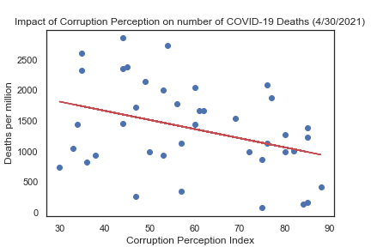
A LOT OF NOTHING
Creating scatter plots to see the relationship between GDP, Human Development Index (HDI) and Corruption perception showed ups that there was little to no correlation between any of these metrics and Cases or Deaths per million.
r² = 0.0
r² = 0.0
r² = 0.0
r² = 0.08
r² = 0.02
r² = 0.13

Slide 3
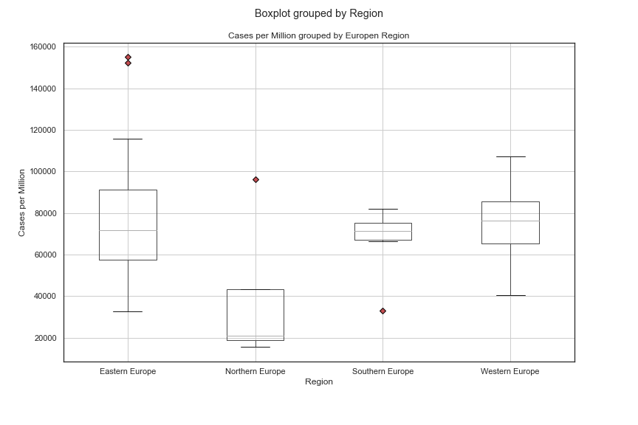
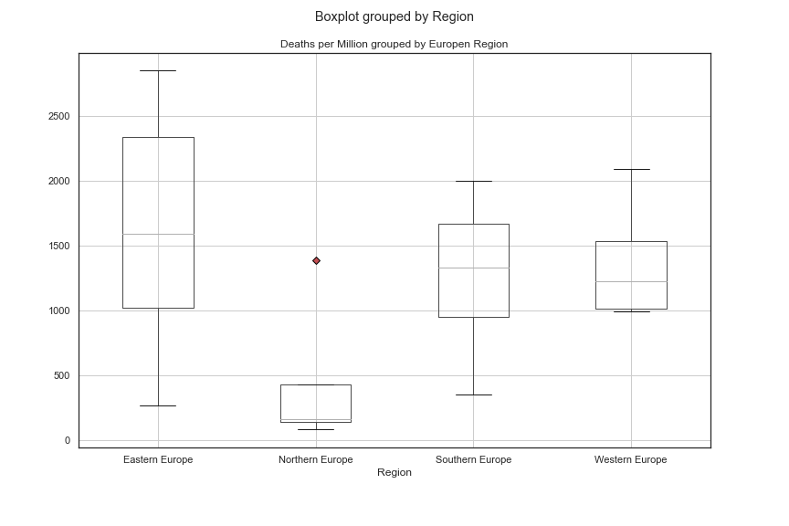
Stacking Up the Boxes
Czechia
Montenegro
Sweden
Sweden
Greece
By simply charting a boxplot of the different regions, we could see that Northern Europe looked different enough from the other three regions to be worth investigating.

Slide 4
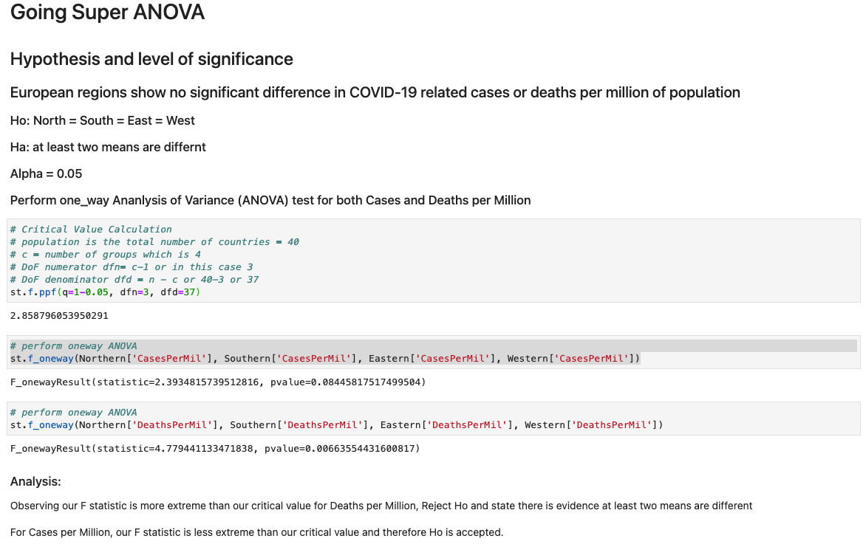
ANOVA
For Cases per Million, H₀ was accepted with a p-value of 0.0845 against an Alpha of 0.05
For Deaths per Million H₀ was rejected with a p-value of 0.0066 against an Alpha of 0.05

Slide 5
T-Tests by Region
Cases per Million
Region | Northern | Southern | Eastern
Southern | 0.17456
Eastern | 0.09409 | 0.45341
Western | 0.04081 | 0.63630 | 0.15506
The ANOVA test showed that there were differences in at least one region for Deaths per Million, but we were curious exactly which region or regions were different.
For Cases per Million, the only combination with p-value less than 0.05 was Northern Europe vs Western Europe.
For Deaths per Million, Northern Europe had p-values less than 0.05 for both Eastern and Western Europe.
Deaths per Million
Region | Northern | Southern | Eastern
Southern | 0.15572
Eastern | 0.02734 | 0.41709
Western | 0.04365 | 0.85791 | 0.20632

